Slide 1
NHS Meeting
August 26th, 2015

Slide 2
Officer Introductions
Ali Karamali – President
Katie Horton – Vice President
Sami Lyons & Grace Seger– Secretaries
Sam Ockerhausen – Treasurer
Allie Jones- Historian

Slide 3
Remind 101 Info
If you are not already signed up for Remind 101 or you were somehow dropped, text ******

Slide 4
Hours Policies
32 hours are required for members (4 Recycling, 3 Neon Run, 25 Others)
Half are due by December 20th
HOURS SUBMITTED ONLINE THIS YEAR
Google form is located on the NHS website: oenhs.weebly.com
Hours must be submitted within the month they are completed
We do verify sponsor contact information and we have a time stamp of when you turn it in
ONLY HALF OF YOUR HOURS MAY COME FROM SCHOOL ACTIVITES
Theatre – only performances will count
All Hawk Leaders will receive 8 hours of community service
The hours spreadsheet will be updated twice a month

Slide 6
Meetings
During the meeting we will be doing community service projects
This means meetings will start at 7:00 a.m. on Wednesdays
If you aren't there by 7:10 you will NOT receive credit for being there unless you spoke to your officer about your situation
Projects will include
Veteran Letters
Meals on Wheels
Mini Pumpkins
Operation Christmas Child
Thanksgiving in a Box
Snowflakes
Valentines Cards
Crafts to retirement homes
Letters to Teachers
Breakfast for teaches

Slide 7
Lunches for Members
For the month of September ALL members can sign up to do lunches on the website.
Each Lunch will count for 10 minutes of community service
6 lunches=1 Hour

Slide 8
Recycling
Members must complete FOUR recyclings
Recycling is on Thursdays from 7:45-8:15 am
If you cant make it, tell your officer and they will reschedule you
Sessions are split up by officer group
Each officer group has four weeks to complete their recycling
First session: TOMORROW
Check in with your officer/Sam when you get there to recycle

Slide 9
Recycling Schedule
Ali – Sept 8th, Oct 27th, Dec 15th, Feb 23rd,
Katie – Sept 15th, Nov 3rd, Jan 12th, Mar 2nd,
Sami – Sept 22nd, Nov 10th, Jan 19th, Mar 9th,
Grace – Sept 29th, Nov 17th, Jan 26th, Mar 23rd,
Sam – Oct 6th, Dec 1st, Feb 2nd, Mar 30th,
Allie– Oct 13th, Dec 8th, Feb 16th, April 6th,

Slide 10
Dues
$10
Must be turned in NO LATER THAN October 5th
Dues cover part of the costs of stoles and t-shirts

Slide 11
Important Dates
This year the Neon Run will be on OCTOBER13TH.
We will have more details for you soon
Induction this year is NOVEMBER 2nd
Hooding Ceremony is April 5th
Carnation Sale is sometime in February

Slide 12
Pics for Purpose/Nick Aaronson

Slide 13
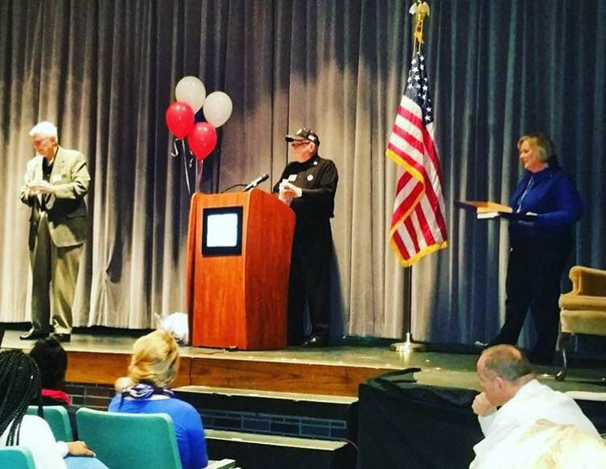
Service Project for Meeting
Honor Flight:
Last year Olathe East was honored by the Heartland Honor Flight for our service to veterans. Our school was awarded a flag that flew over Washington DC on September 11th of last year.

Slide 14
Please check in with your officer :
A-C: Ali Karamali
D-G: Katie Horton
H-K: Allie Jones
L-N: Sam Ockerhausen
O-Si: Sami Lyons
Sm-W: Grace Seger

